Slide 1
Status of research projects
Crosslinking separation: manuscript ready to submit;
N-terminal enrichment: working on labeling efficiency of PFP-biotin with macrophage digest;
Palmitoylation identification: enrichment by biotinylation;
Farnesylation enrichment

Slide 2
Identification and Enrichment Study of Farnesylated Peptides and Proteins
Zixiang Fang
08/21/2018

Slide 3
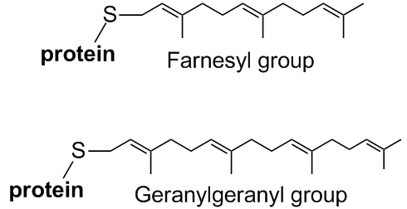
Prenylation
Localization and interacting activities of modified proteins.
Includes farnesylation and geranylgeranylation.
Involved in transforming activities of many oncogenic proteins.
Ras proteins are found related to more than 30% of human cancers.
MW of farnesyl group: 204.19 Da
MW of geranylgeranyl group: 272.46 Da
M. Wang and P. J. Casey, Nature Reviews Molecular Cell Biology 2016, 17, 110-122.
Y. C. Wang and M. D. Distefano, Bioorganic Chemistry 2016, 64, 59-65.
N. Saxena, S. S. Lahiri, S. Hambarde and R. P. Tripathi, Cancer Investigation 2008, 26, 948-955..
Notes:
Isoprene n. Isoprenoid adj. pyrophosphate
Modification happens at the side chain of cysteine in the C-terminus of the protein.
Farnesyl: 3 isoprene moieties; GG: 4 isoprene moieties;
They are intensively studied because

Slide 4
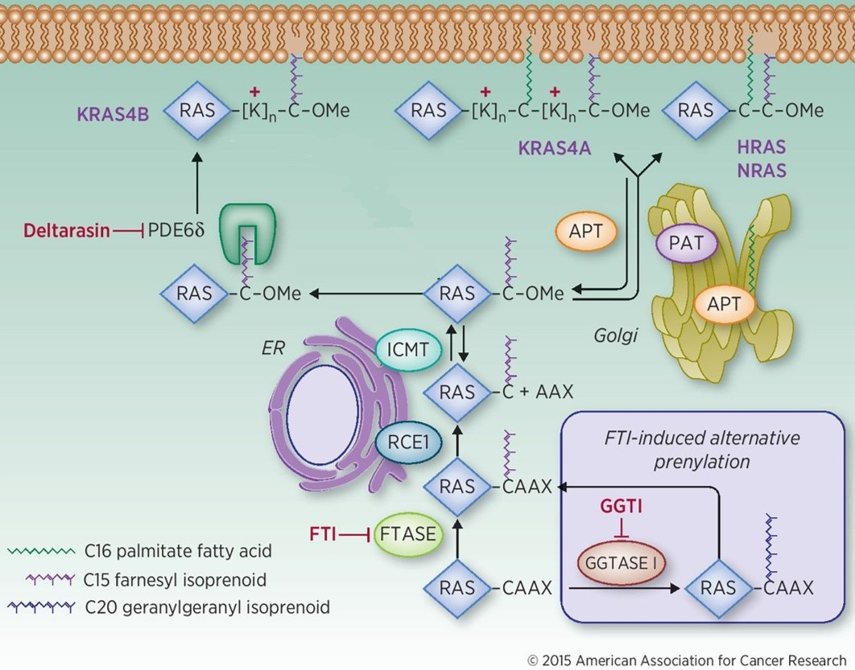
Ras lipidation pathway
Ras signaling is crucial for survival and proliferation of cells.
Ras protein binds with GTP and GDP to switch between “on” and “off” states.
Ras is the most commonly mutated oncogene in cancers.
Lipidation facilitates the attachment of Ras proteins to membrane.
KRas4b has the polybasic sequence to interact electrostatically with membrane.
A. D. Cox, C. J. Der and M. R. Philips, Clinical Cancer Research 2015, 21, 1819-1827;
N. Vasan, J. L. Boyer and R. S. Herbst, Clinical Cancer Research 2014, 20, 3921-3930.
Notes:
Introduce the meaning of CAAX: A(aliphatic); other proteins functions of Ras proteins
Normal Ras signaling is crucial…
However, Ras is also the most commonly…
Normal Ras protein will bind with GTP and GDP to switch on and off states for cell growth. For mutated Ras protein, the growth of cells are constantly activated. Thus these cells become cancer cells.

Slide 5
Method for prenylation identification
Oxidation strategy for identifying prenylation
Signature fragment in CID MS² after losing “RSOH”
R. P. Bhawal, S. C. Sadananda, A. Bugarin, B. Laposa and S. M. Chowdhury, Analytical Chemistry 2015, 87, 2178-2186;
R. P. Bhawal, A. D. A. Shahinuzzaman and S. M. Chowdhury, Journal of the American Society for Mass Spectrometry 2017, 28, 704-707.
Notes:
Creates distinct and abundant peak;

Slide 6
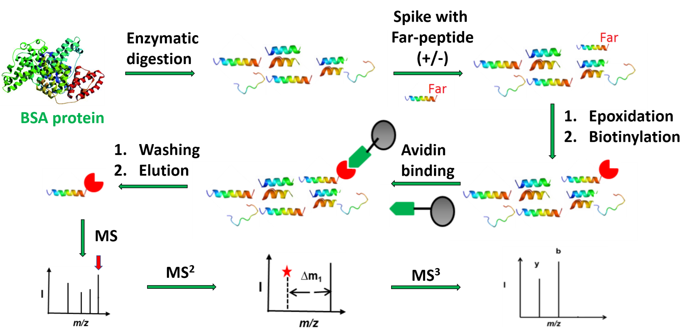
Strategy for farnesyl peptide enrichment
Peptide sequence: REKKFF(Far-)CAIL (MW:1457.88 Da)
Majorek, K. A.; Porebski, P. J.; Dayal, A.; Zimmerman, M. D.; Jablonska, K.; Stewart, A. J.; Chruszcz, M.; Minor, W. Molecular Immunology 2012, 52 (3-4), 174–182.
Notes:
Ratio between protein and peptide concentrations? Binding efficiency? What general kinds of interactions? What acidic condition do to the avidin? Denature?? Understand biotin and avidin and the chemistry behind it!!! How strong the interaction? What term should I use to describe it?

Slide 7
Biotinylation procedures
RSOH
Biotin maleimide
(BM)
Biotin enrichment
group

Slide 8
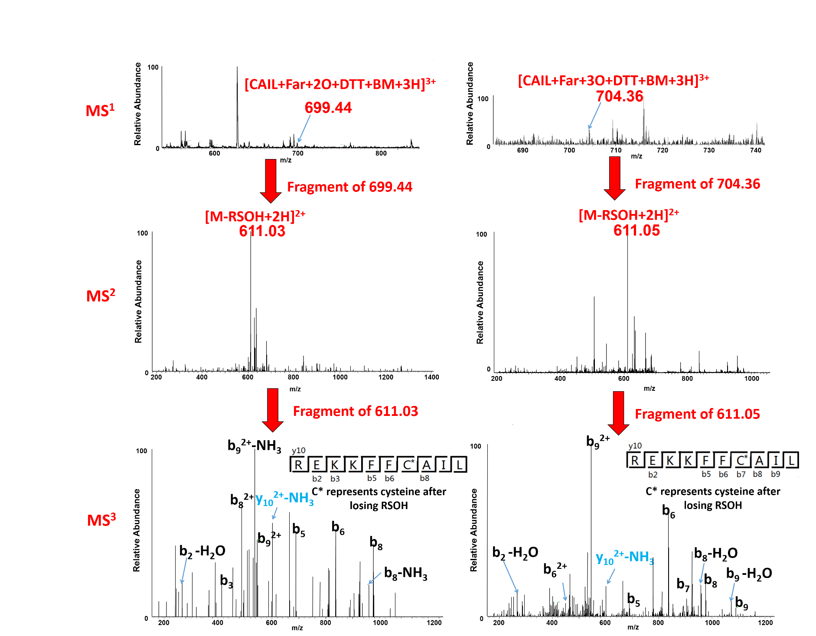
Preliminary results of enriched biotinylated peptides
Precursor: 699.44 [Far-CAIL+2O+DTT+BM]³⁺
Precursor: 704.36 [Far-CAIL+3O+DTT+BM]³⁺
1457.88(Far-peptide) + 47.98(3O) + 154.01(DTT) + 451.19(BM)
= 2111.06 Da
1457.88(Far-peptide) + 31.99(2O) +154.01(DTT)+451.19(BM)
= 2095.07 Da

Slide 9
Enrichment study of prenylated peptide and protein
1. Optimization of derivatization
Reduce reaction steps by biotin-hydrazide
2 . Large-scale identification of prenylated proteins
Enrichment of KRAS (186 amino acids, ~21kDa) from protein mixture
Identify unknown prenylated targets from macrophage cell lysate
Biotin group

Slide 10
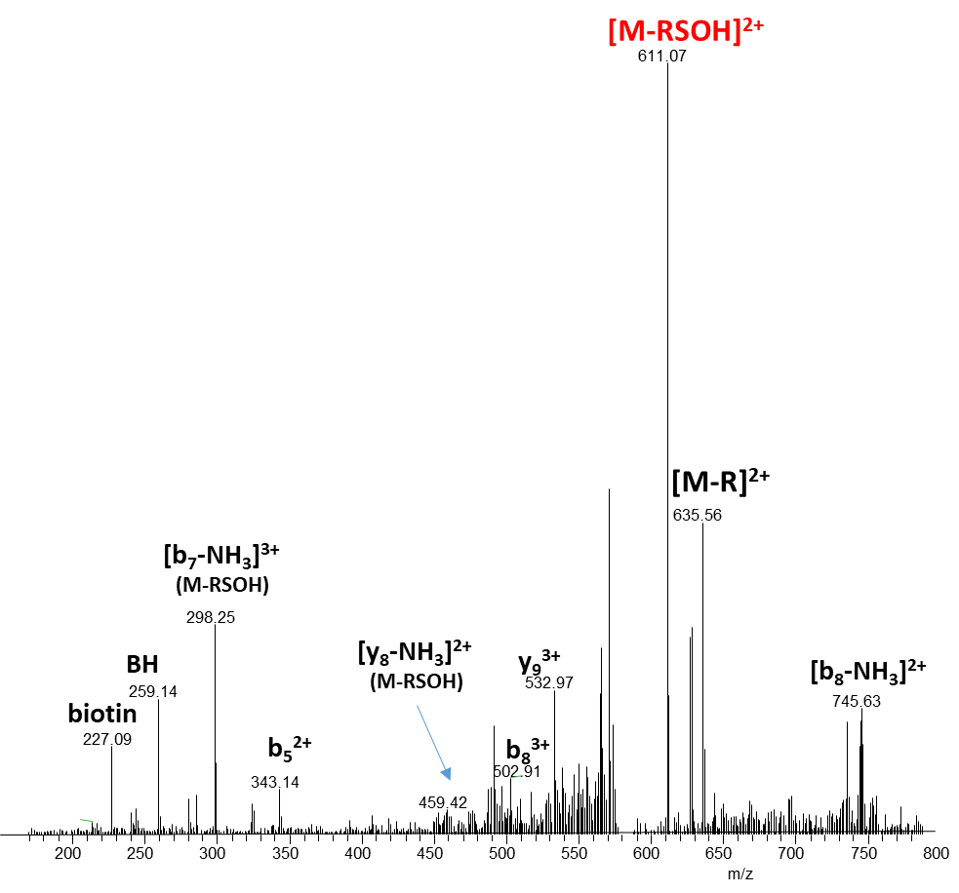
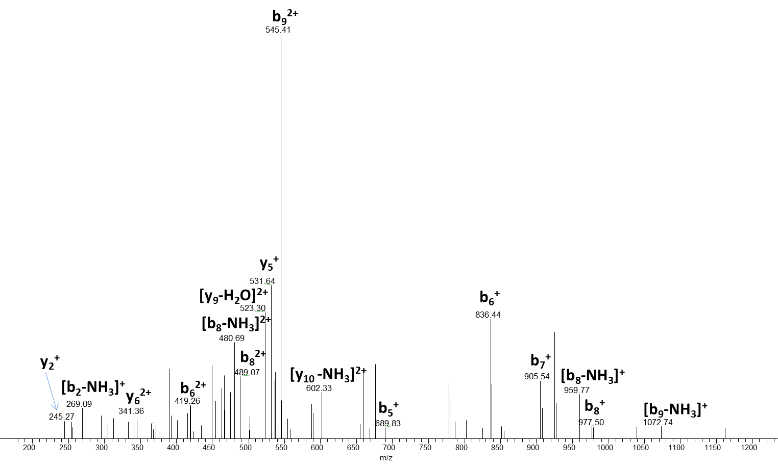
MS2 and MS3 of farnesylated REKKFFCAIL
Precursor: 583.52 [Far-CAIL+2O+BH]³⁺
1457.88(Far-peptide) + 31.99(2O) +258.34 (BH)
= 1748.21 Da
MS/MS of 611.07

Slide 11
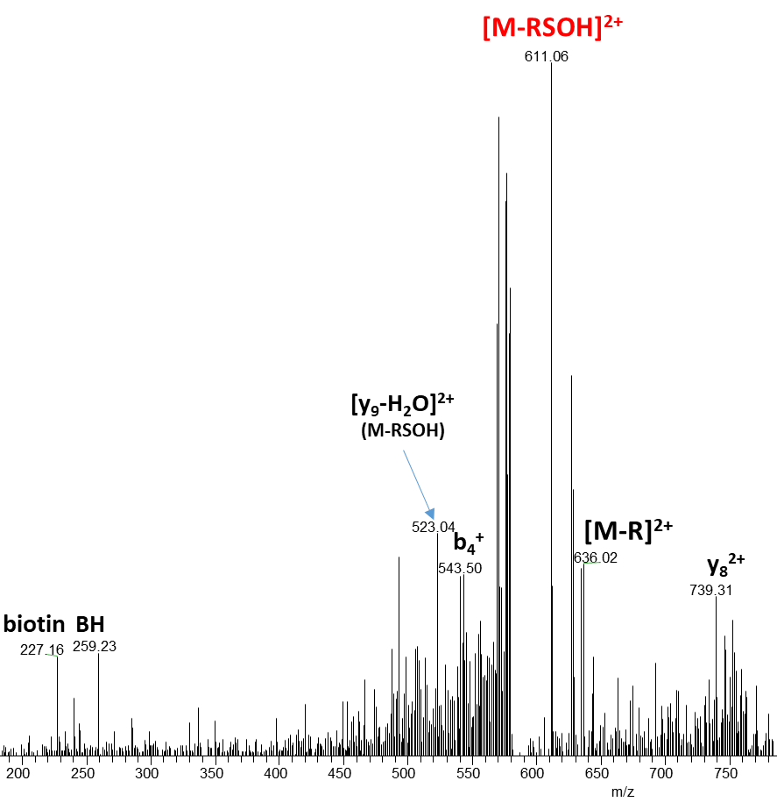
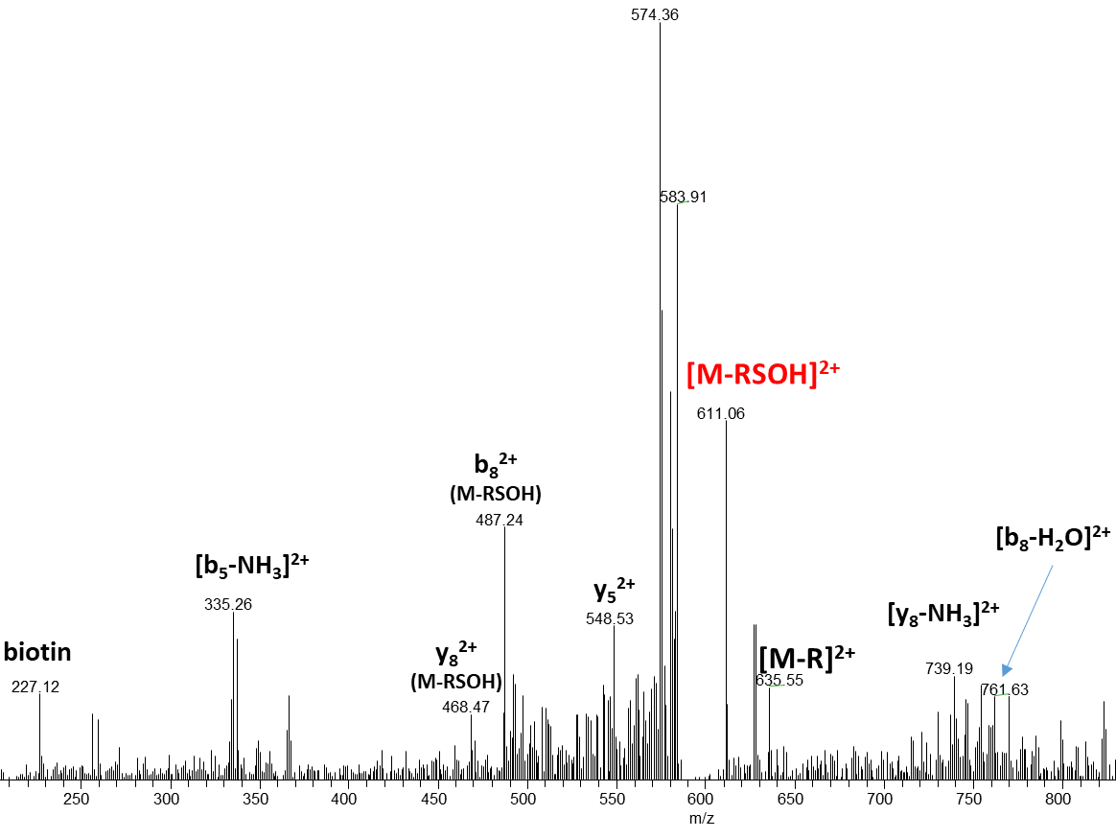
MS2 of farnesylated REKKFFCAIL
Precursor: 588.29 [Far-CAIL+3O+BH]³⁺
Precursor: 592.87 [Far-CAIL+4O+BH]³⁺
1457.88(Far-peptide) + 47.98(3O) +258.34 (BH)
= 1764.21Da
1457.88(Far-peptide) + 63.98(4O) +258.34 (BH)
= 1780.20Da

Slide 12
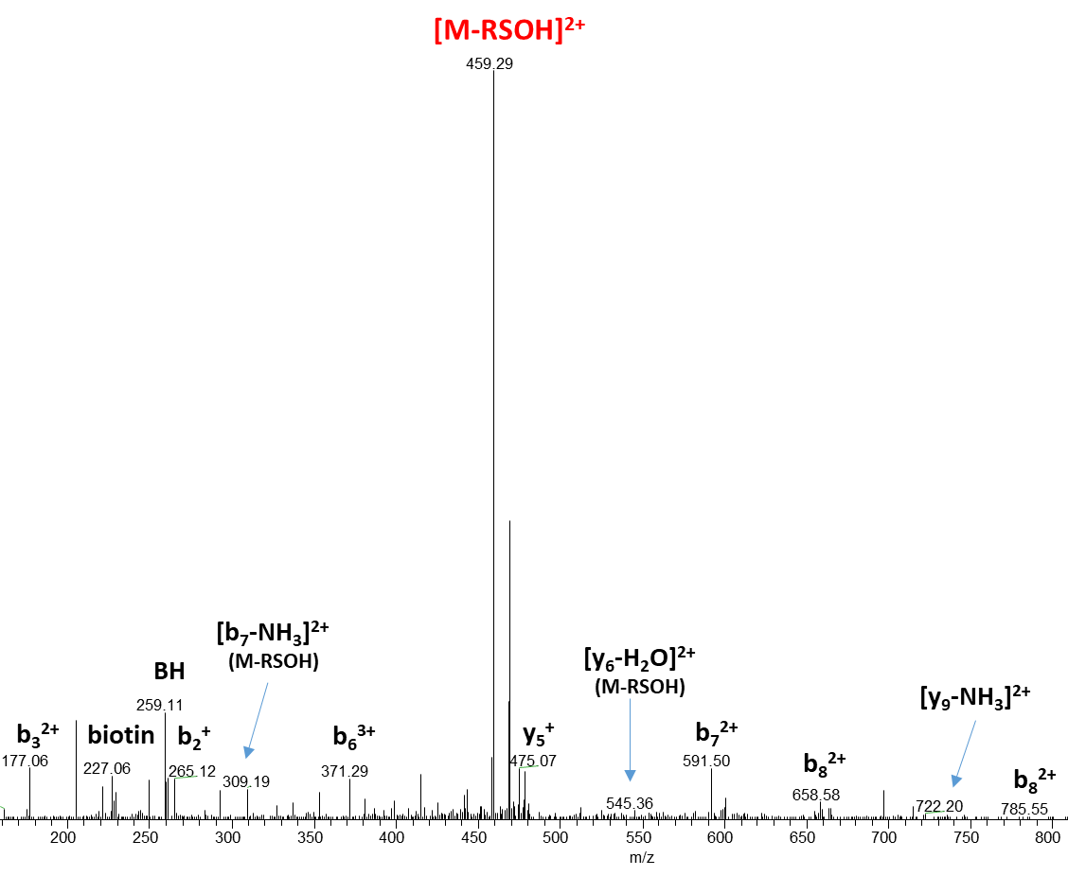
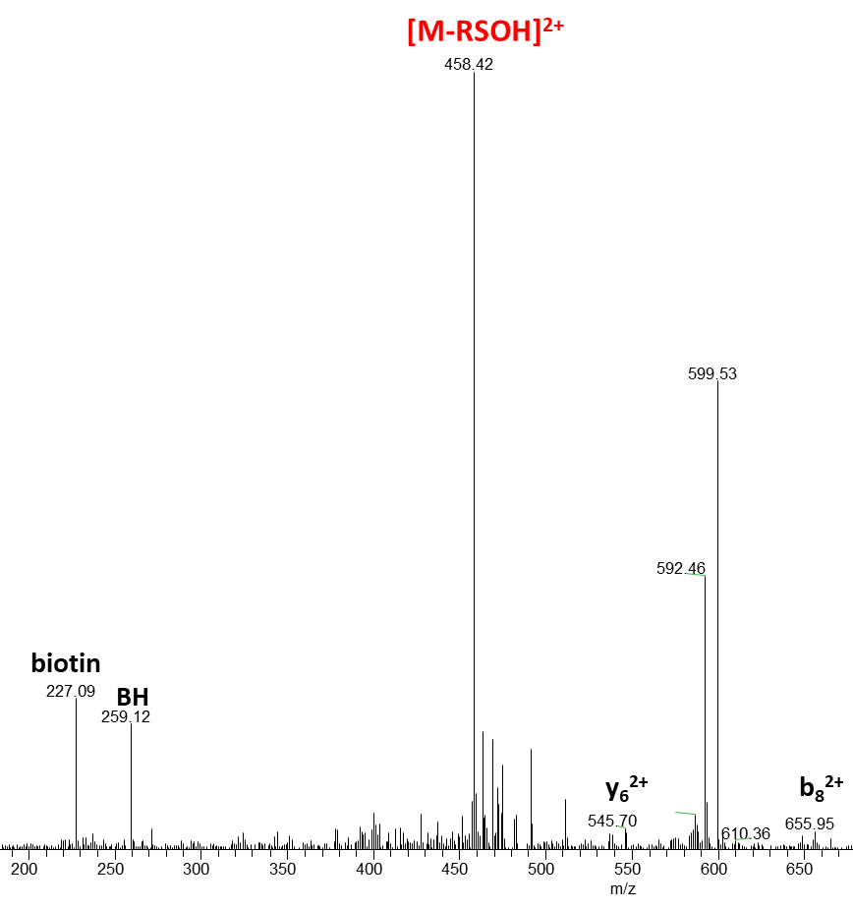
MS2 of farnesylated KHSSGCAFL
Precursor: 481.54 [Far-CAFL+2O+BH]³⁺
1152.64(Far-peptide) + 31.99(2O) +258.34 (BH)
= 1442.97 Da
Precursor: 487.22 [Far-CAFL+3O+BH]³⁺
1152.64(Far-peptide) + 47.98(3O) +258.34 (BH)
= 1458.96 Da

Slide 13
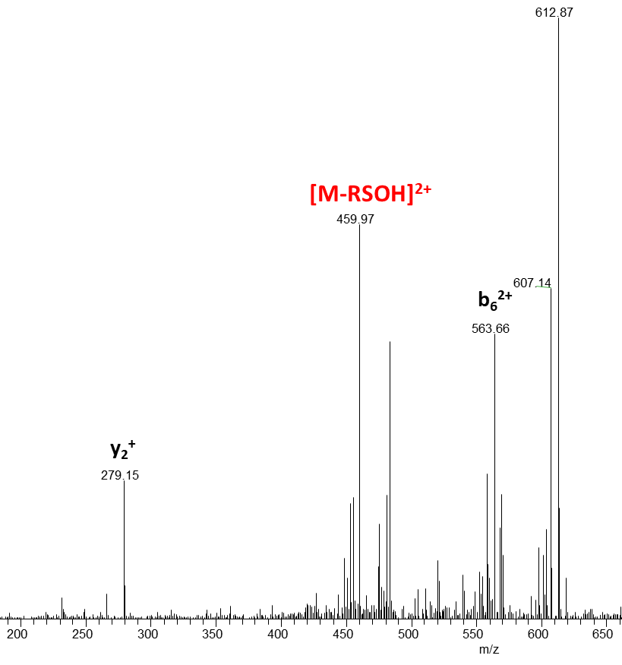
MS2 of farnesylated KHSSGCAFL
Precursor: 493.32 [Far-CAFL+4O+BH]³⁺
1152.64(Far-peptide) + 63.98(4O) +258.34 (BH)
= 1474.96 Da

Slide 14
KRas4b protein sequence
MTEYKLVVVGAGGVGKSALTIQLIQNHFVDEYDPTIEDSYRKQVVIDGETCLLDILDTAGQEEYSAMRDQYMRTGEGFLCVFAINNTKSFEDIHHYREQIKRVKDSEDVPMVLVGNKCDLPSRTVDTKQAQDLARSYGIPFIETSAKTRQGVDDAFYTLVREIRKHKEKMSKDGKKKKKKSKTKCVIM
Notes:
This is the sequence of Kras 4b protein. In order to study the prenylation of polybasic sequence of Kras 4b protein, we customized the C-terminal sequence in red, performed farnesylation and use endoproteinase GluC to digest the peptide. This sequence is what we get after digestion.
Lots of lysines in the sequence, which may not behave the way as the regular prenylated peptides we have done experiment before.

Slide 15
Enrichment study of Kras 4b C-terminal peptide
Non-enriched
Spike and Enrichment study
Farnesyl GKKKKKKSKTKC peptide
10uL, 1mM Farnesyl GK6 peptide
spiked in 10uL, 1mM BSA/Myo/Ubi digested soln.
10uL, 20mM mCPBA , 0 ℃, 20 mins
mCPBA , 0 ℃, 20 mins
Epoxidized far-GK6
Epoxidized far-GKKKKKKSKTKC
5uL, 50mM Biotin hydrazide in pH5, PBS, 37 ℃, 2h
Biotin hydrazide
LCMS
Enrichment
LCMS

Slide 16
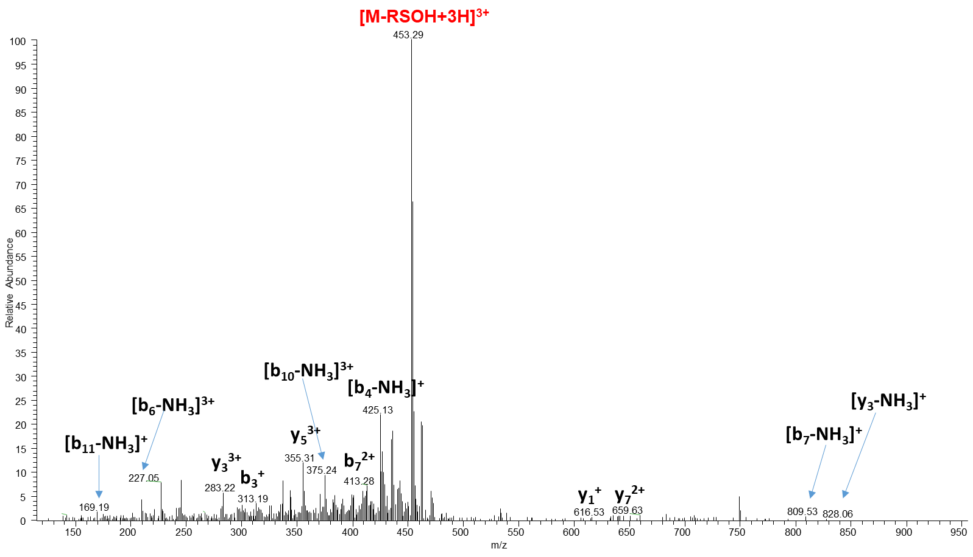
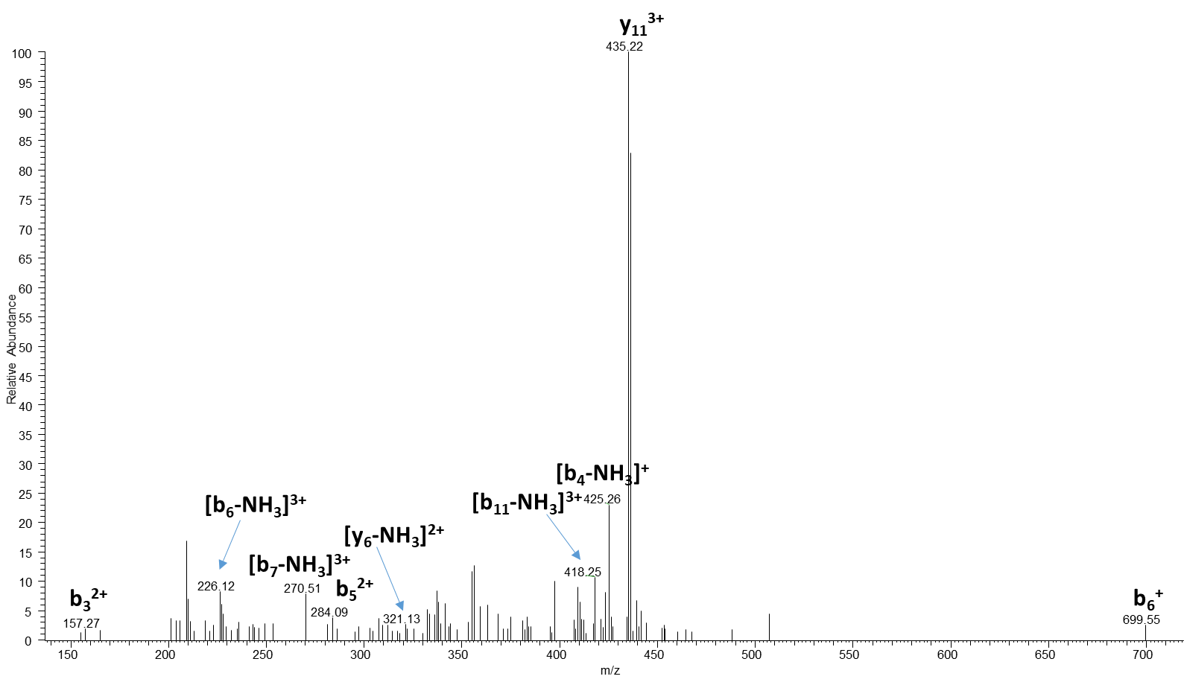
MS2 and MS3 of the non-enriched far-GK6
Precursor: 472.00 [Far-GK6+2O+BH]⁴⁺
MW: 1390.88058 + 204.1877904 (far) + 2*15.994915 (oxi) +258.34(BH) =
MS/MS of 453.29

Slide 17
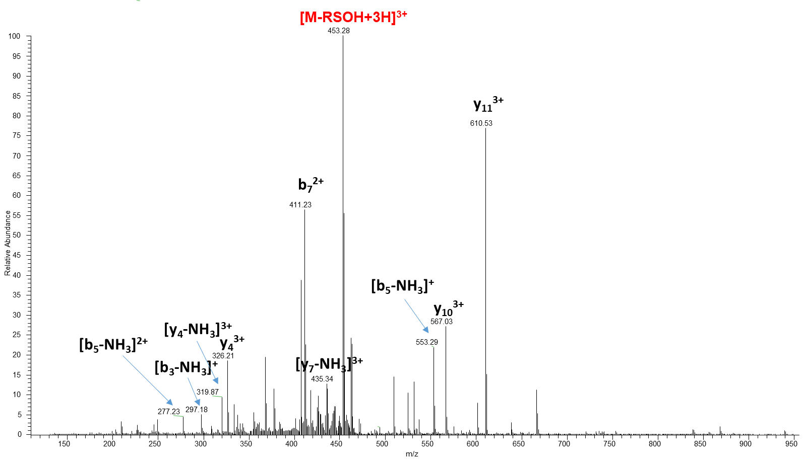
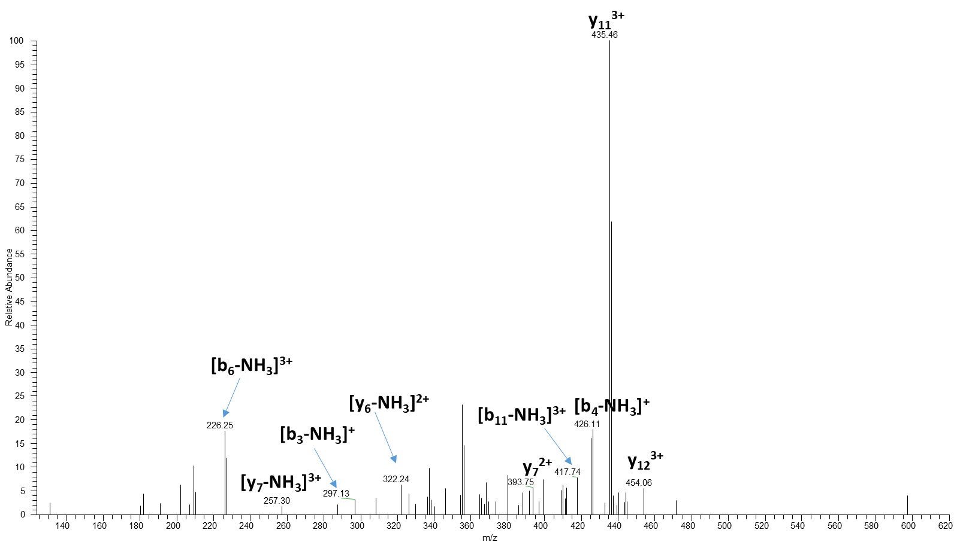
MS2 and MS3 of the spiked and enriched far-GK6
Precursor: 472.00 [Far-GK6+2O+BH]⁴⁺
MW: 1390.88058 + 204.1877904 (far) + 2*15.994915 (oxi) +258.34(BH) =
MS/MS of 453.28

Slide 18
Efficiency of enrichment in far-GK6 identification
Comparison of extracted chromatogram of Far-GK6+2O+BH
Non-enriched
Enriched

Slide 19
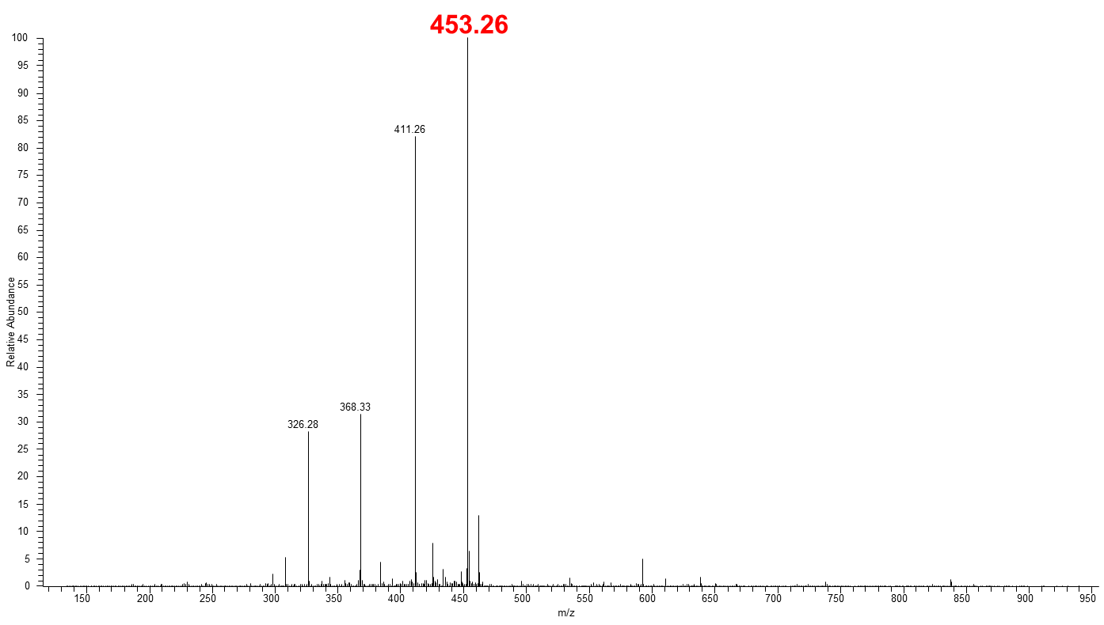
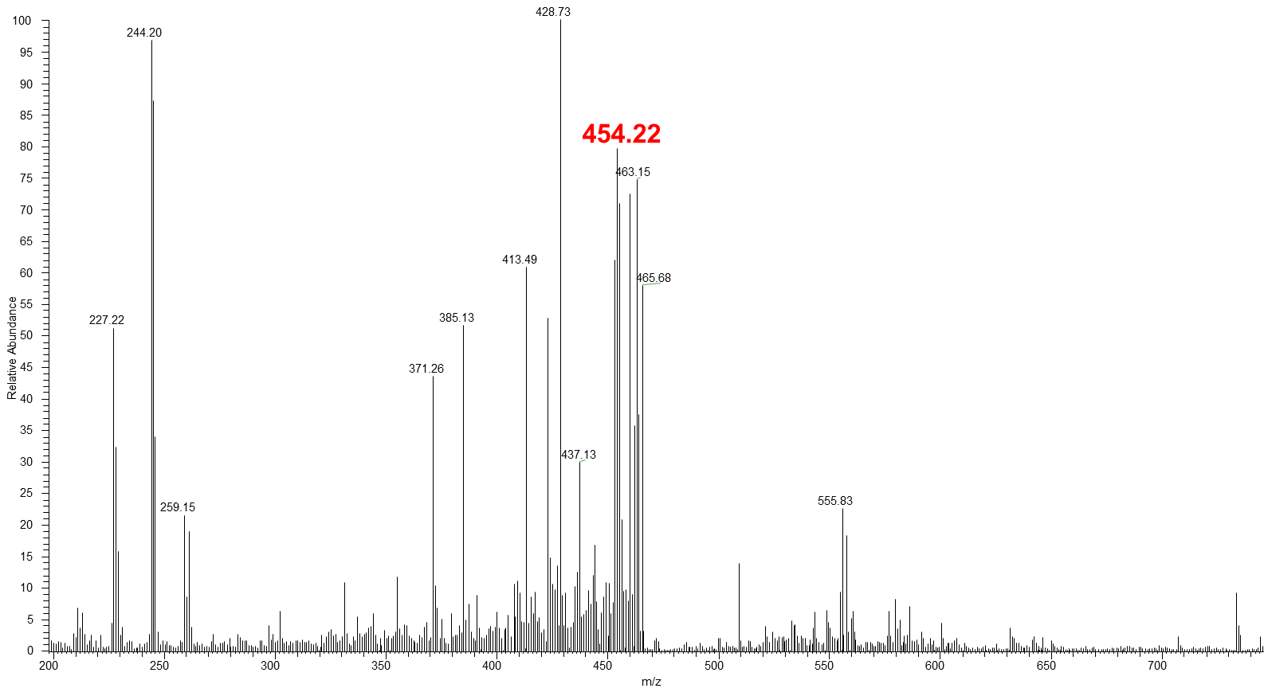
Efficiency of enrichment in far-GK6 identification
Comparison of average spectrum of Far-GK6+2O+BH
Non-enriched
Enriched

Slide 20
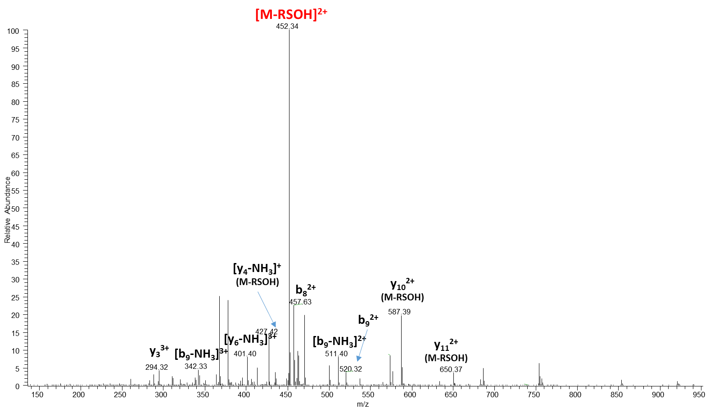
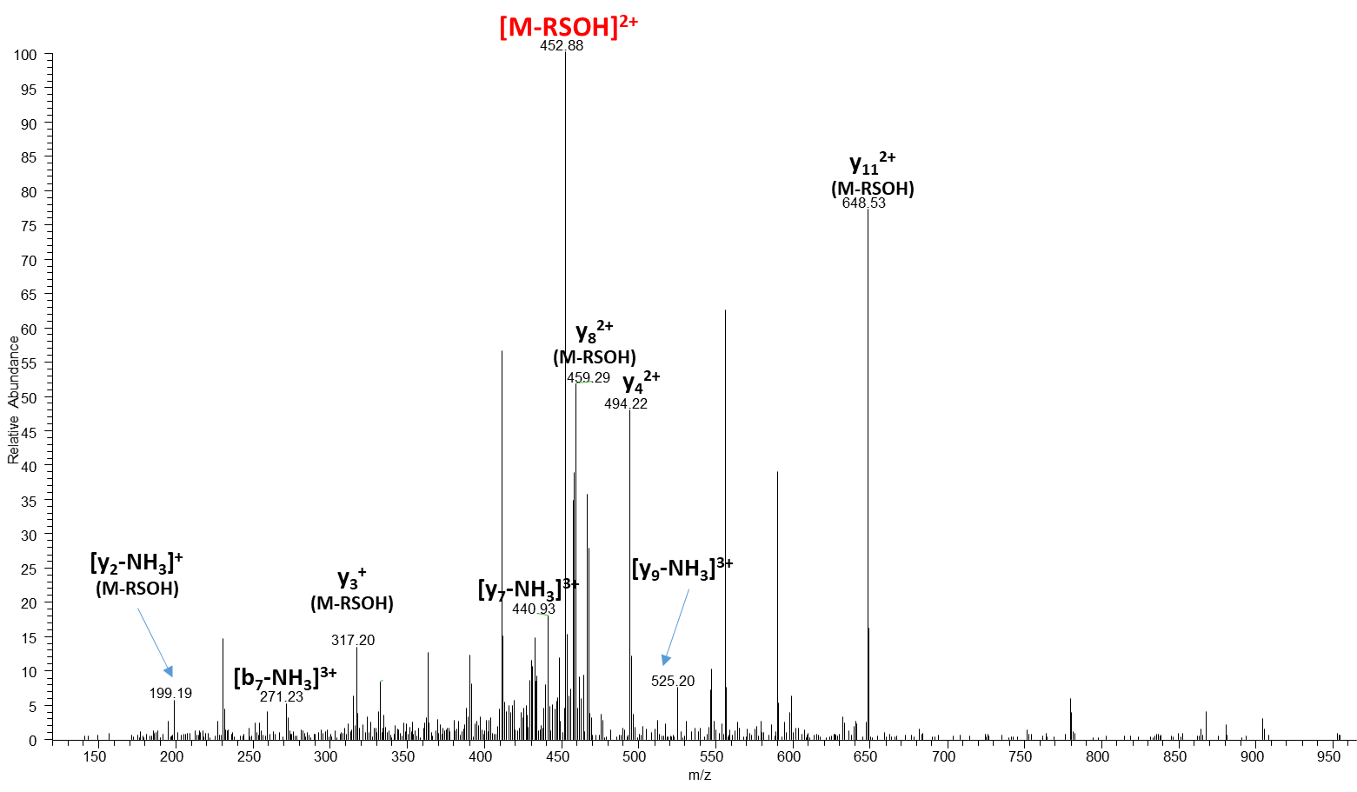
MS2 of the spiked and enriched far-GK6
Precursor: 476.22 [Far-CAIL+3O+BH]⁴⁺
1595.07(Far-peptide) + 47.98(3O) +258.34 (BH)
= 1901.39Da
Precursor: 592.87 [Far-CAIL+4O+BH]⁴⁺
1595.07(Far-peptide) + 63.98(4O) +258.34 (BH)
= 1917.39 Da

Slide 21
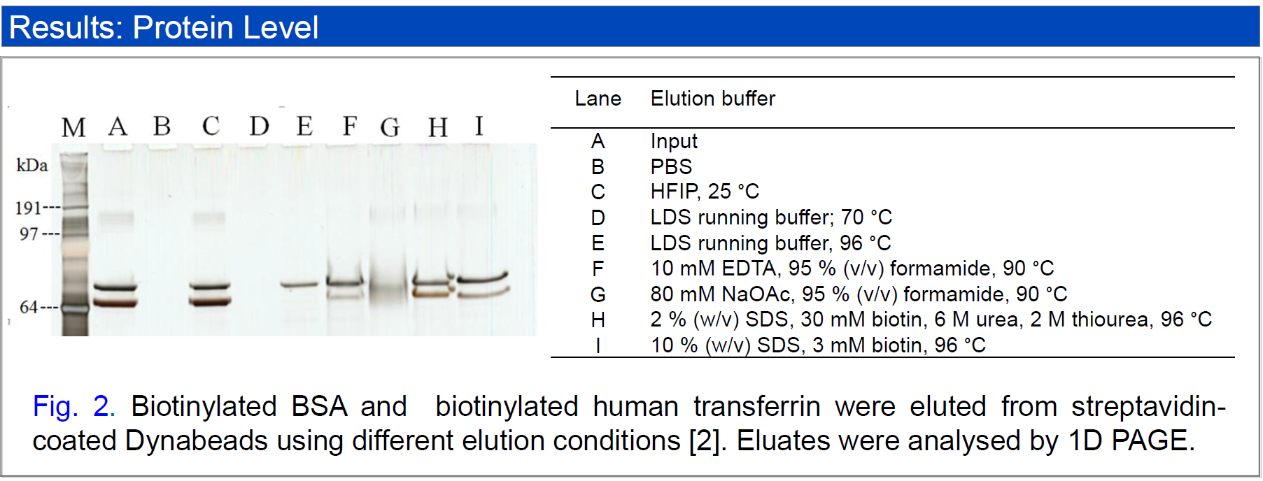
HFIP for protein enrichment

Slide 22
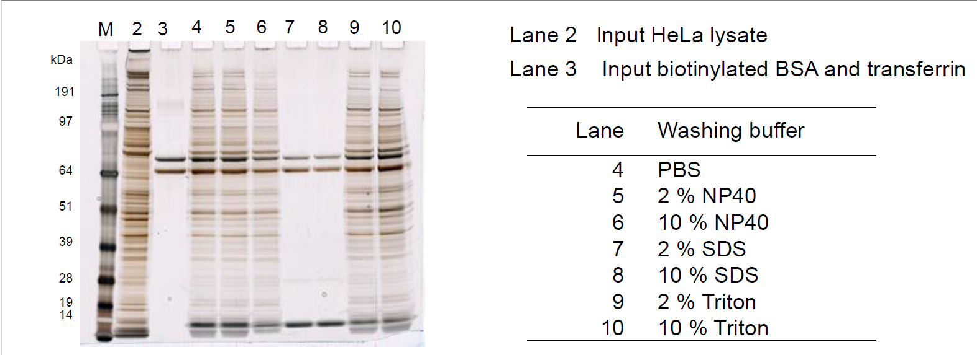
Different washing solutions in HFIP enrichment

Slide 23
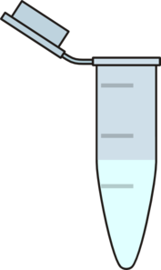
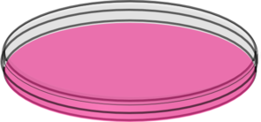
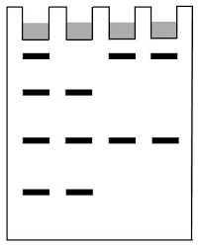
Enrichment study of prenylated proteins in large-scale sample
Biotin hydrazide
Cell lysis
MeOH/CHCl3
DTT/IAA
epoxidation
Raw macrophage cell
LPS(+/-)
Cell lysate
protein complex
Streptavidin binding
PBS/SDS washing
SDS-PAGE
HFIP elution
Potential prenylated protein identifications
23

Slide 24
BSA/CytoC/Kras/Myo
control
BSA/CytoC/Kras/Myo
HFIP+PBS
BSA/CytoC/Kras/Myo
HFIP+SDS
Raw Mac control HFIP+PBS
Raw Mac control HFIP+SDS
Raw Mac LPS HFIP+PBS
Raw Mac LPS HFIP+SDS
Raw Mac control
Raw Mac LPS
150kD
100kD
75kD
50kD
37kD
25kD
20kD
15kD
10kD

